Slide 1

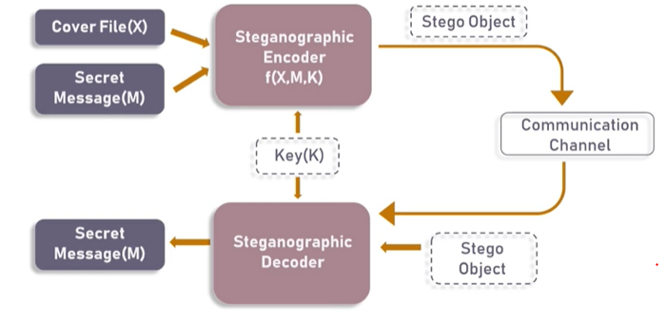

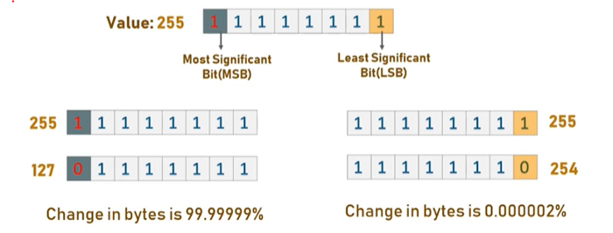
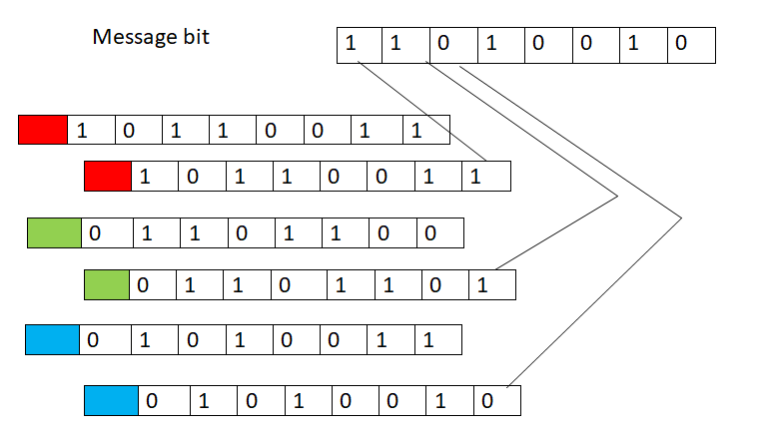
DATA HIDING In an Image for Secret communication
Nivedha.U, Divya.S
ABSTRACT.
This project proposes a secured data hiding technique in the spatial domain of image steganography.
The type of image steganography used here is LSB Steganography.
The proposed scheme takes the binary message bit and replaces the least significant bit of the converted binary pixel value.
The embedding procedure is done in a way that there will be no sign of original message inside the cover object and, obviously, without using any outside key.`
ADVANTAGES
It can be used for secret communication
This method is simple, easy to understand
Using a slight modification, we can ensure greater security of the message.
Steganography doesn’t show the existence of hidden information as in encryption.
This doesn’t reduce the clarity or quality of image.
Can be implemented in any multimedia files like audio, video, etc..,
General architecture
Both the original image file(X) and secret message (M) that needs to be hidden are fed into a Steganographic encoder as input.
Steganographic Encoder function, f(X,M,K) embeds the secret message into a cover image file by using techniques like least significant bit encoding.
The resulting stego image looks very similar to your cover image file, with no visible changes. This completes encoding.
To retrieve the secret message, stego object is fed into Steganographic Decoder.
General architecture
PROCESS
Think an image as a matrix (or a two-dimensional array) of pixels which contains a fixed number of rows and columns. These pixels will have colors in RGB or RGBA format whose values ranges from 0 to 255. We convert these values into binary format so that we can insert the message bits in it.
The message to be converted will be in the form of alphabets. These alphabets must be converted to binary. This is done by finding ASCII values(which are in decimal form) for each alphabets. Then we convert those decimal values into binary
Then the least significant bit of each RGB values are replaced by one of the message bits in order to encode the message.
The reverse process is done for decoding the message.

